Slide 1
Media Queries
Designing for Different Screen Sizes | Media Queries | Types of Media | Media Features | Break Points
Notes:
Welcome to our lecture on Media Queries. In this lecture we will go through Designing for Different Screen Sizes, Media Queries, Types of Media, Media Features, Break Points
. Let’s start our lecture.

Slide 2
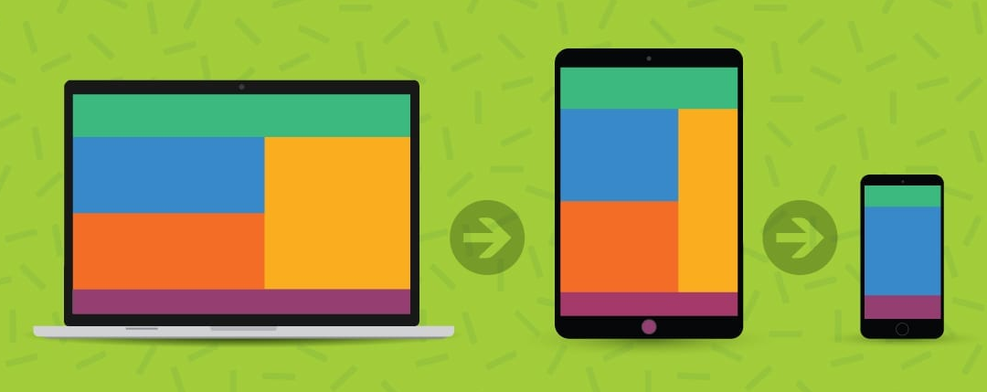
Designing for Different Screen Sizes
Screen Sizes: Websites are designed for desktop, tablet, and mobile viewports.
Graceful Degradation: Start with a desktop design and adjust for smaller screens.
Progressive Enhancement: Begin with mobile design and adapt for larger screens.
Notes:
Websites are designed for various screen sizes, including desktop, tablet, and mobile viewports. Two key strategies are used. Graceful degradation starts with a desktop design and adjusts it for smaller screens. Progressive enhancement begins with a mobile-first design and adapts it for larger screens. These approaches ensure websites look and function well across all devices.

Slide 3
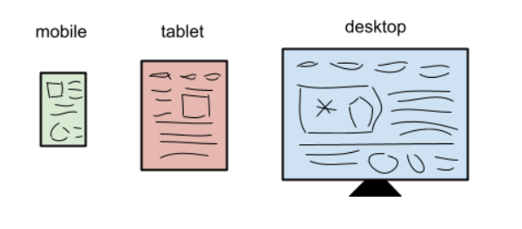
Designing for Three Platforms
Notes:
Web design focuses on three main platforms: mobile, tablet, and desktop. Each platform has unique viewport sizes and user needs. Developers use responsive design techniques to create layouts that adapt seamlessly across these devices. By optimizing for all three, websites provide a consistent and user-friendly experience regardless of screen size or device type.

Slide 4
Media queries
Responsive Web Design: Adapts webpage layouts to different screen sizes using media queries.
Media Queries: Combine media types (e.g., screen, print) with features (e.g., height, orientation) to evaluate conditions.
Fluid Layouts: Ideal for desktop and mobile but may require responsive design for better mobile compatibility.
Notes:
Now we will discuss the Media queries that are essential for responsive web design, allowing layouts to adapt to various screen sizes. They combine media types like screen or print with features such as height or orientation to apply specific styles. Fluid layouts work well for both desktop and mobile but often require media queries to enhance compatibility, ensuring an optimized user experience across devices.

Slide 5
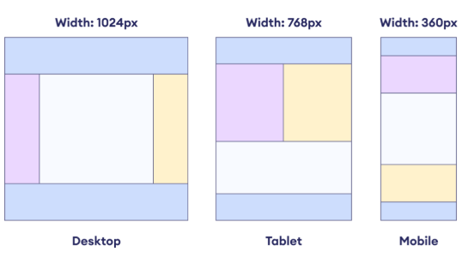
Responsive Web Design Across Devices
Notes:
Responsive web design ensures webpages adapt seamlessly to different screen sizes, such as desktop, tablet, and mobile. It uses flexible layouts and media queries to rearrange content based on device width, as shown in the examples. This approach provides an optimized user experience, making websites accessible and visually appealing across all devices.

Slide 6
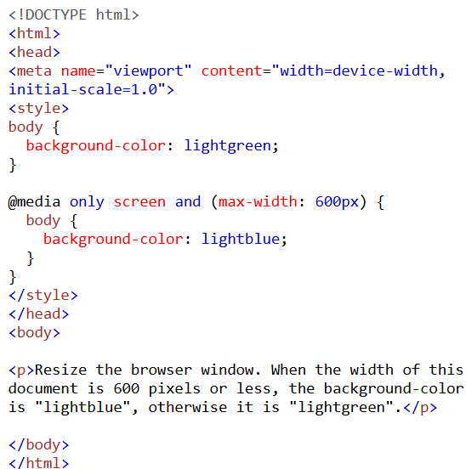
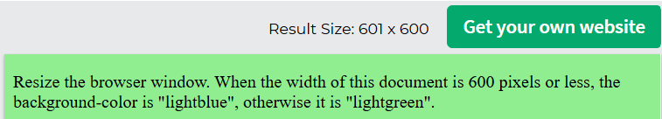
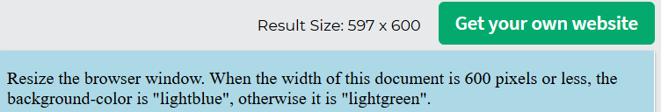
Media Query Example
Notes:
This slide shows an example of a media query in action. The background color changes based on the browser width. When the width is 600 pixels or less, the background becomes light blue. Otherwise, it remains light green. The viewport meta tag ensures proper scaling. Media queries like this help create responsive designs by adapting styles to different screen sizes dynamically.

Slide 7
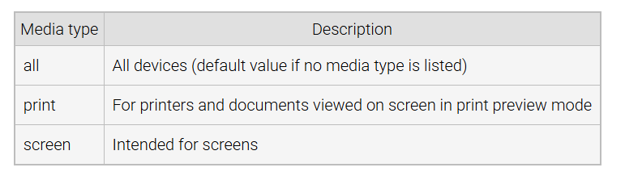
Types of Media Used in Media Queries
Notes:
Media queries use different media types to target specific devices or scenarios. The "all" type applies to all devices and is the default if no type is specified. The "print" type is used for printers or print preview mode, optimizing styles for printed documents. The "screen" type is intended for screens, making it ideal for responsive design across desktops, tablets, and mobile devices.

Slide 8
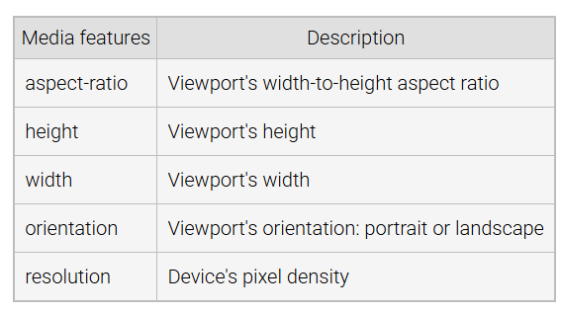
Media Features Used in Media Queries
Notes:
Media queries use various features to target device properties. The aspect-ratio feature specifies the width-to-height ratio of the viewport. Height and width define the viewport's dimensions. Orientation distinguishes between portrait and landscape modes, while resolution targets the device's pixel density. These features help developers create responsive designs tailored to specific devices and conditions.

Slide 9
Break Points
Breakpoints: Screen widths that trigger media queries to display, resize, or hide content.
Content Focus: Use breakpoints based on content needs, not specific devices.
Example: @media screen and (max-width: 800px) has a breakpoint of 800px.
Viewport Meta: Include <meta name="viewport" content="width=device-width, initial-scale=1"> for proper breakpoint functionality.
Notes:
Now Let’s discuss breakpoints that define screen widths where media queries trigger changes in content display, resizing, or visibility. They should focus on content requirements rather than specific devices. For example, in the media query with max-width 800px, 800px is the breakpoint. Always include the viewport meta tag for proper functionality, ensuring responsive designs adapt accurately across devices.

Slide 10
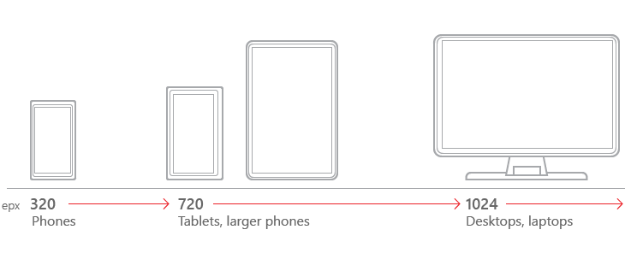
Mobile, Tablet and Desktop Break Points
Notes:
Breakpoints are essential for responsive web design, targeting different screen sizes. Common breakpoints include 320px for mobile phones, 720px for tablets and larger phones, and 1024px for desktops and laptops. These values help developers create layouts that adapt to the user's device, ensuring an optimal viewing experience across all screen sizes.

Slide 11
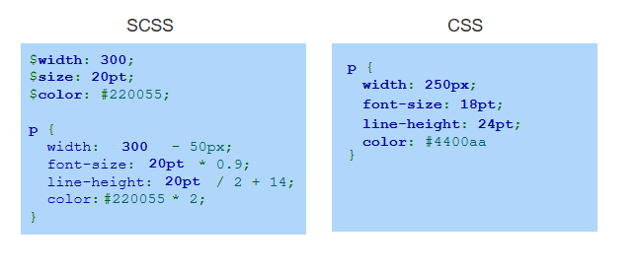
Example
Notes:
This example compares SCSS and CSS. SCSS uses variables like width, size, and color to make the code dynamic and easier to maintain. It also allows calculations directly within styles. When compiled, SCSS outputs standard CSS, as shown on the right. This simplifies the development process and enhances code readability, making stylesheets more flexible and efficient. Thanks for watching the lecture.

